Slide 1
Network Addressing

Slide 2
Address
MAC Address (Hardware or Physical )
IP Address (Logical Address)

Slide 3
MAC
A Media Access Control (MAC) address is a 48-bit (6 bytes) address that is used for communication between two hosts in an Ethernet environment.
It is a hardware address, which means that it is stored in the firmware of the network card (NIC).

Slide 4
MAC addresses are usually written in the form of 12 hexadecimal digits. For example, consider the following MAC address:
D8-D3-85-EB-12-E3

Slide 5
How to find out your own MAC address?

Slide 6
IP Address
An IP address is a 32-bit number that identifies a host on a network
An IP address is usually written in the form of four decimal numbers separated by periods (.)
Example
10.2.3.4

Slide 7
172.25.219.96 cmd
139.167.143.182 public
Default gateway 172.25.216.1
g

Slide 8
How to find out your IP address?

Slide 9
Using CMD
Using Google

Slide 10
Private IP address of a system is the IP address which is used to communicate within the same network. Using private IP data or information can be sent or received within the same network.
Public IP address of a system is the IP address which is used to communicate outside the network. Public IP address is basically assigned by the ISP.

Slide 11
Private addresses ranges
10.0.0.0 – 10.255.255.255
172.16.0.0 – 172.31.255.255
192.168.0.0 – 192.168.255.255

Slide 12
Which information can we get from IP Address?

Slide 13
https://viewdns.info/
https://www.whatismyip.com/
https://whois.domaintools.com/
https://www.whois.com/whois/
182.73.197.20 (VIT)
182.72.39.10
182.72.39.9

Slide 14
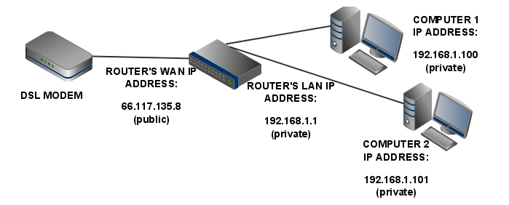




Slide 15








[142.250.71.100

Slide 16
How to map from Private Address to Public and vice versa?

Slide 17
Network Address Translation (NAT)
Network Address Translation (NAT) is a process in which one or more local IP address is translated into one or more Global IP address and vice versa in order to provide Internet access.

Slide 18
Default Gateway
Default Gateway: is an intermediate device between the local network and Global Network.
CMD: Tracert <Domain/IP>

